Slide 1
CHAPTER 13
TAKING THE MEASURE OF STARS

Slide 2
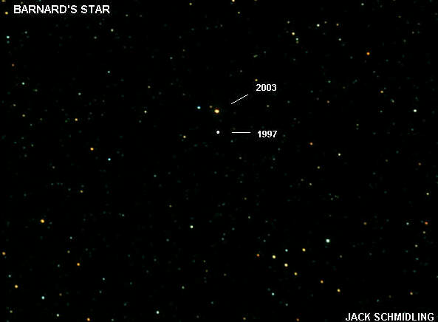

Slide 3
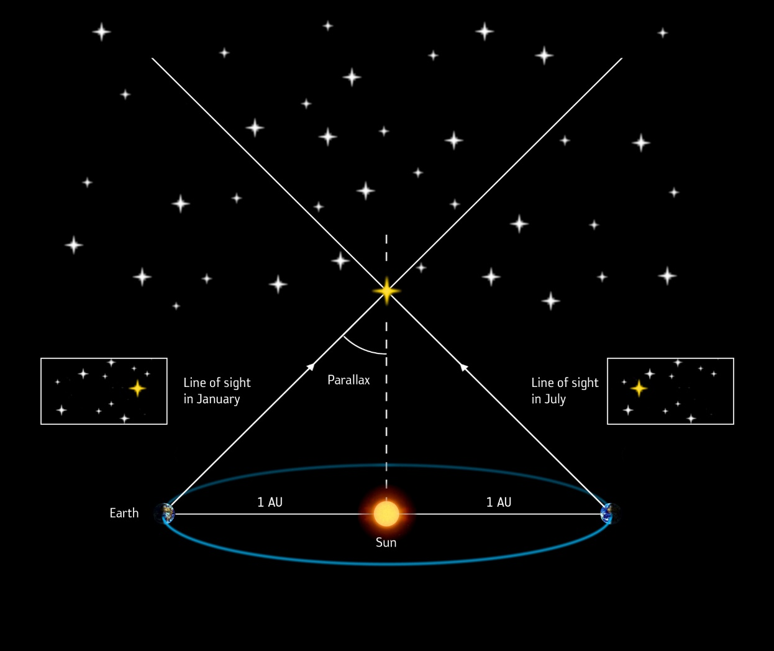
Parallax ESA

Slide 4
In order to measure the distance to a star by parallax it is necessary to know the direction to the star on two different days of the year and
1) nothing else.
2) the star’s luminosity (total energy output per second).
3) the star’s surface temperature.
4) the star’s spectrum.

Slide 5
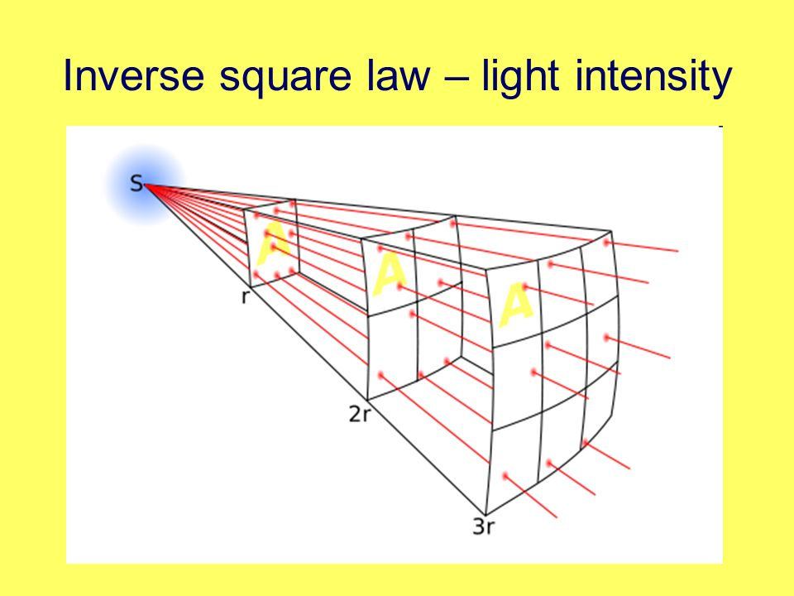

Slide 6
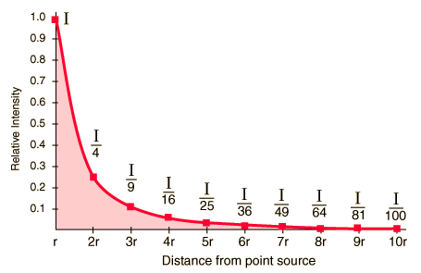
Inverse Square Law

Slide 7
A star viewed a certain distance away is measured to have a brightness b₀. If this star were viewed from 6 times as far away its brightness would be measured as
b₀ C) b₀/36
B) b₀/6 D) 6 b₀

Slide 8
Suppose a star is so distant that its apparent magnitude is greater by 5 than its absolute magnitude. How far away is it?
1) 5 parsecs 2) 10 parsecs
3) 100 parsecs 4) 1000 parsecs

Slide 9
Deneb is a supergiant star in the Northern Cross. It has an apparent magnitude of 1.25 and an absolute magnitude of -8.75. How far away is it?
1) 1.3 pc 2) 100 pc
3) 246.8 pc 4) 1000 pc

Slide 10
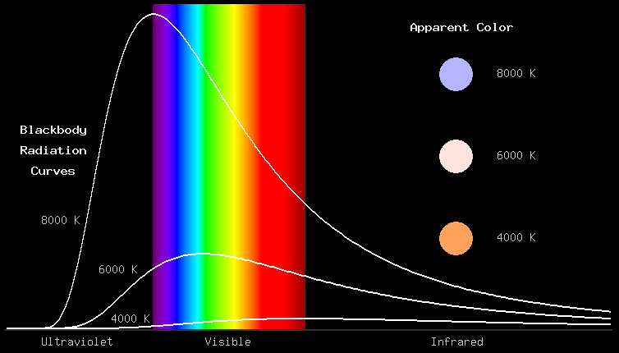

Slide 11
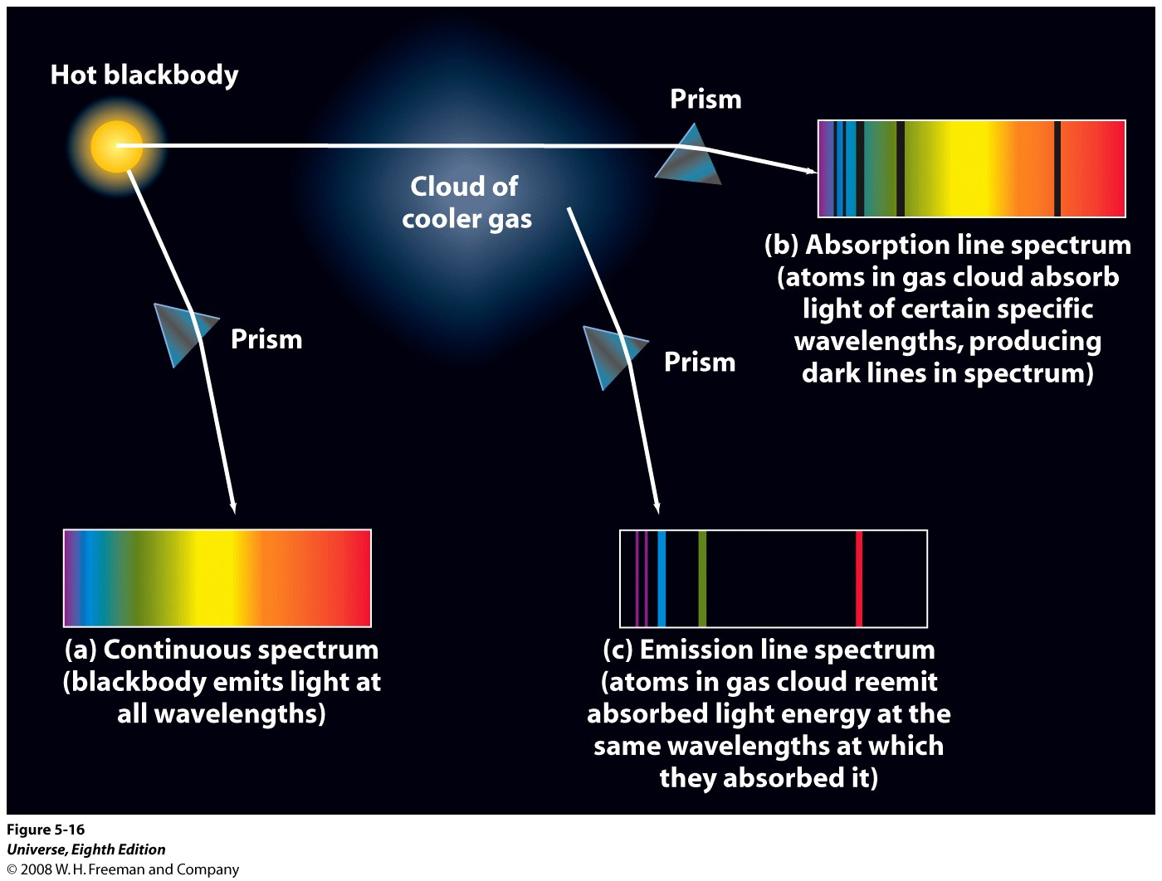
Notes:
Figure 5-16 Continuous, Absorption Line, and Emission Line Spectra
A hot, opaque body (like a blackbody) emits a continuous spectrum of
light (spectrum a). If this light is passed through a cloud
of a cooler gas, the cloud absorbs light of certain
specific wavelengths, and the spectrum of light that
passes directly through the cloud has dark absorption
lines (spectrum b). The cloud does not retain all the
light energy that it absorbs but radiates it outward in
all directions. The spectrum of this reradiated light
contains bright emission lines (spectrum c) with exactly
the same wavelengths as the dark absorption lines in
spectrum b. The specific wavelengths observed depend
on the chemical composition of the cloud.

Slide 12
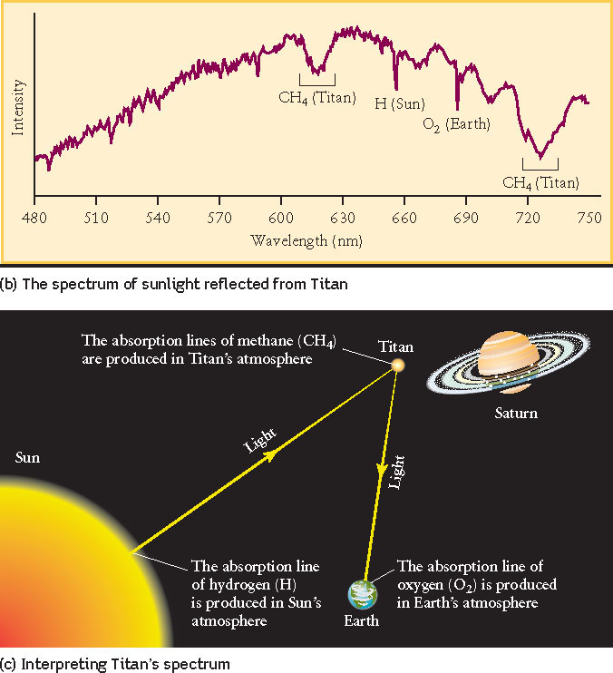
The spectrum of the atmosphere of Titan.

Slide 13
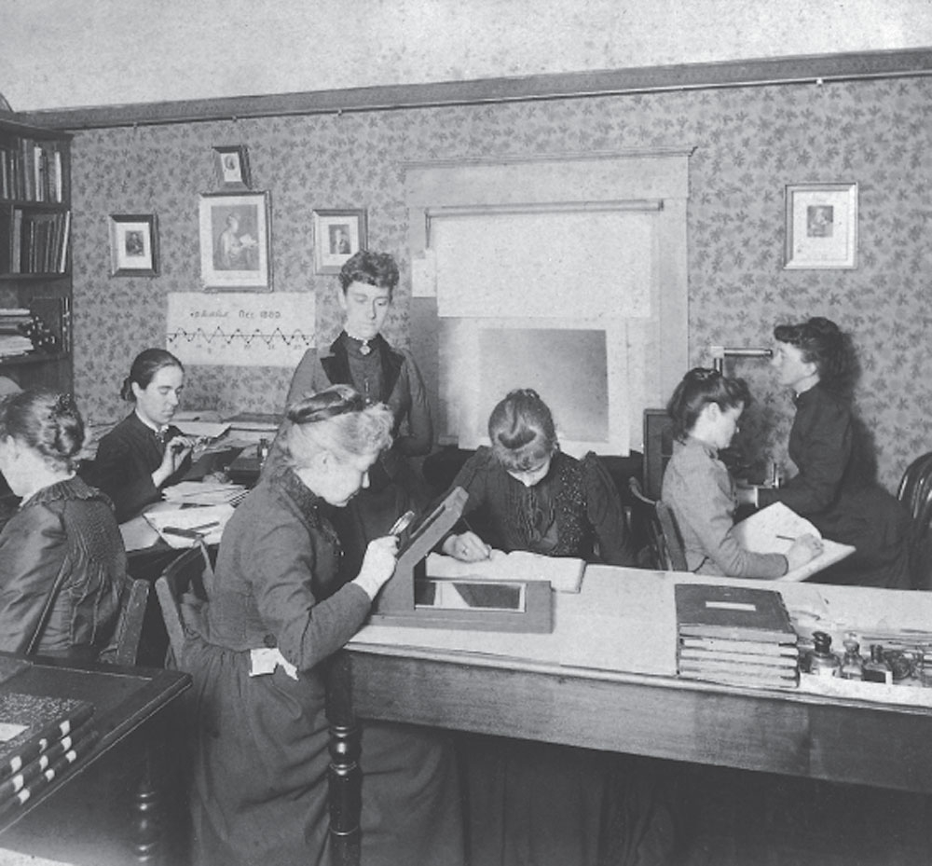

Slide 14
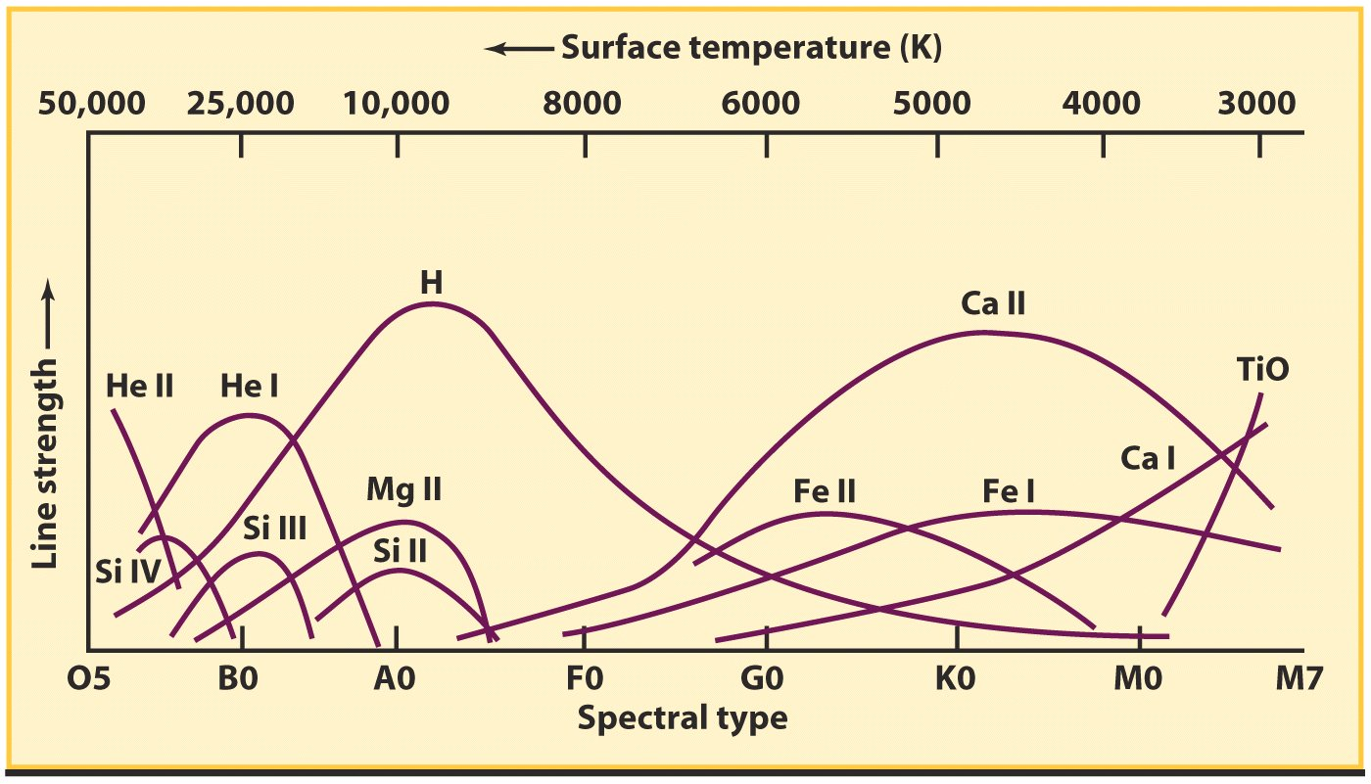
The Strengths of Absorption Lines

Slide 15
The absolute magnitude (M) of a star is most closely related to what other physical parameter of the star?
temperature 3) mass
luminosity 4) age

Slide 16
Which of the following atoms or ions produces strong absorption lines in the spectra of stars with relatively cool surface temperatures?
A) TiO, molecules of titanium oxide
B) Mg II, ionized magnesium
C) Ca II, ionized calcium
D) He I, neutral helium

Slide 17
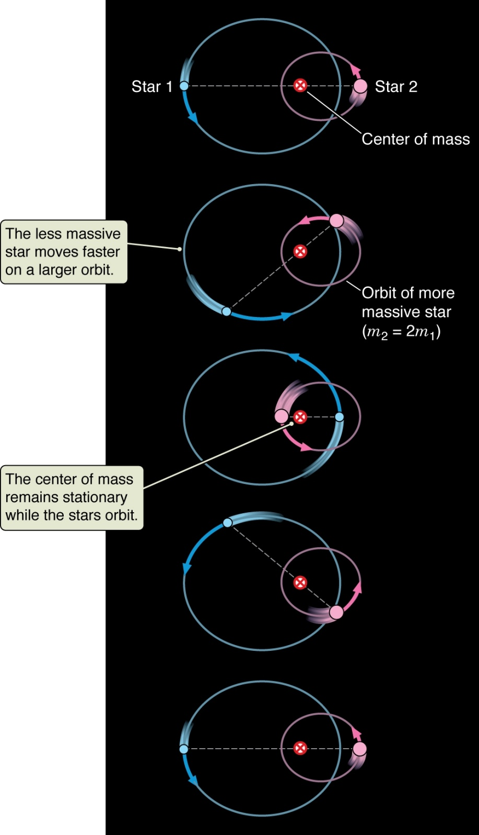
Figure 13.10

Slide 18
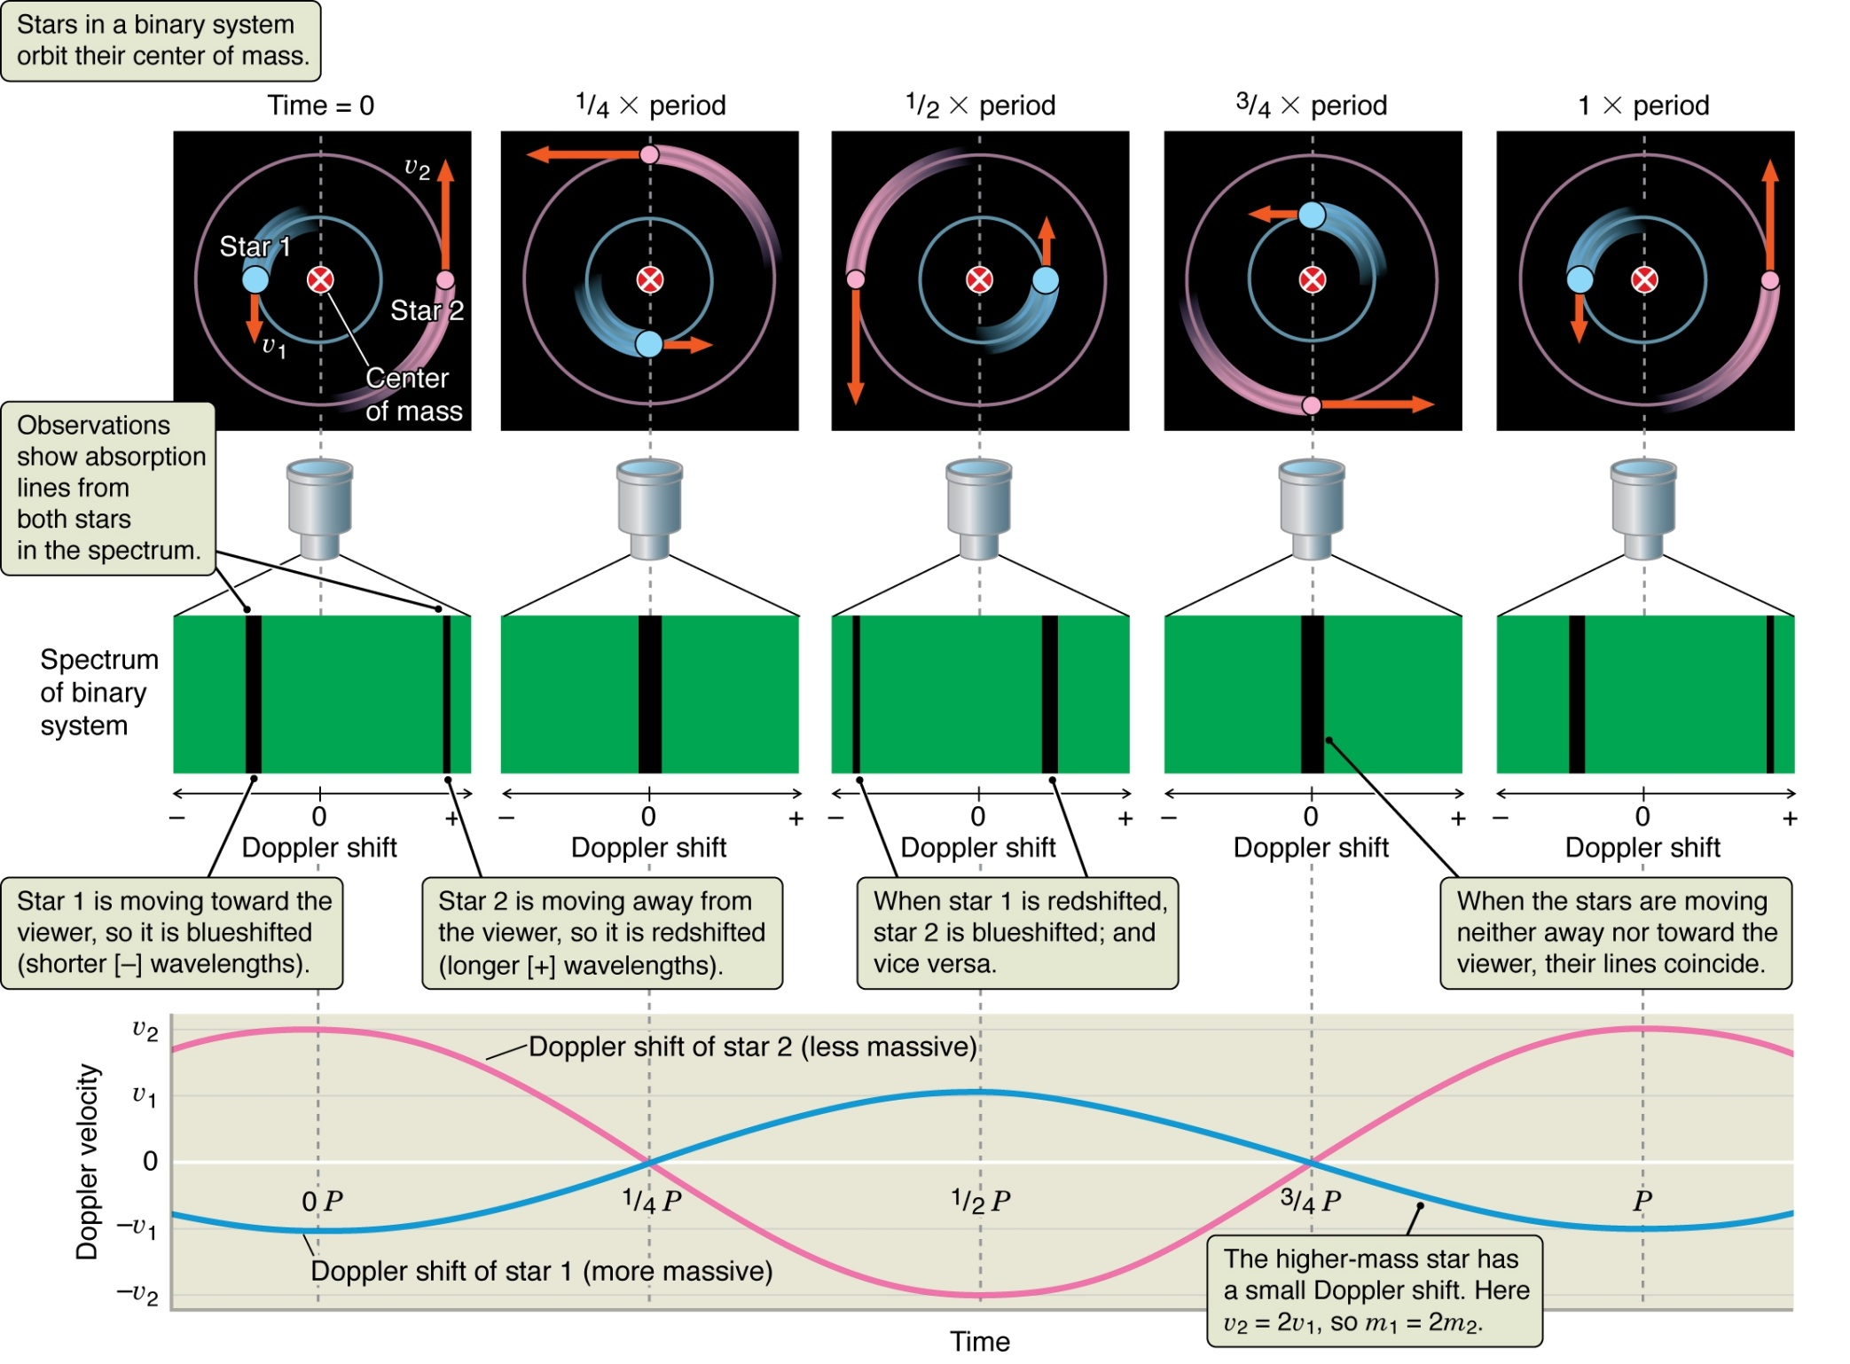
Figure 13.11

Slide 19
What condition is necessary for us to see eclipses of stars in binary star systems?
1) One of the stars must be much bigger than the other so that it can hide its smaller companion when the orbital plane is at a large angle to the line of sight.
2) The stars must have very similar surface temperatures for us to see a significant eclipse whatever the inclination of the orbital plane to the line of sight.
3) The line of sight from Earth to the star system must be in or very close to the orbital plane of the stars.
4) The line of sight from Earth to the star system must be very close to perpendicular to the orbital plane of the stars.

Slide 20
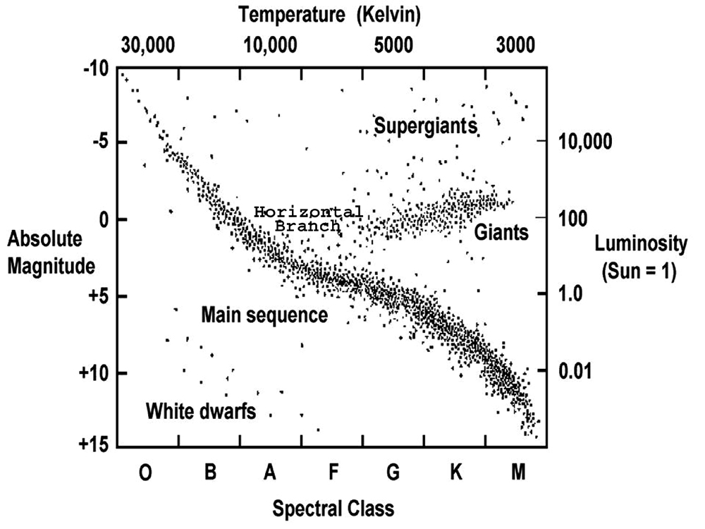

Slide 21
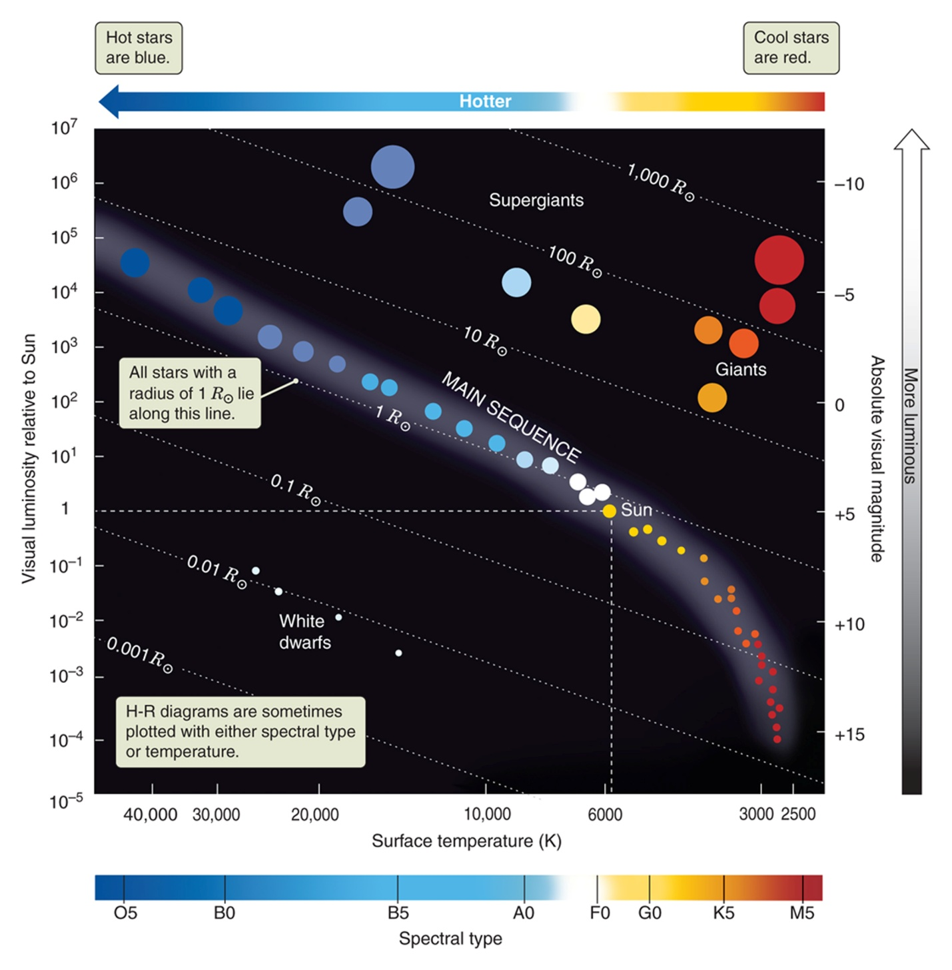
Notes:
FIGURE 13.16 The layout of the H-R (Hertzsprung-Russell) diagram used to plot the properties of stars. More luminous stars are at the top of the diagram. Hotter stars are on the left. Stars of the same radius (R) lie along the dotted lines moving from upper left to lower right. Absolute magnitudes are discussed in Connections 13.1 and Appendix 6.

Slide 22
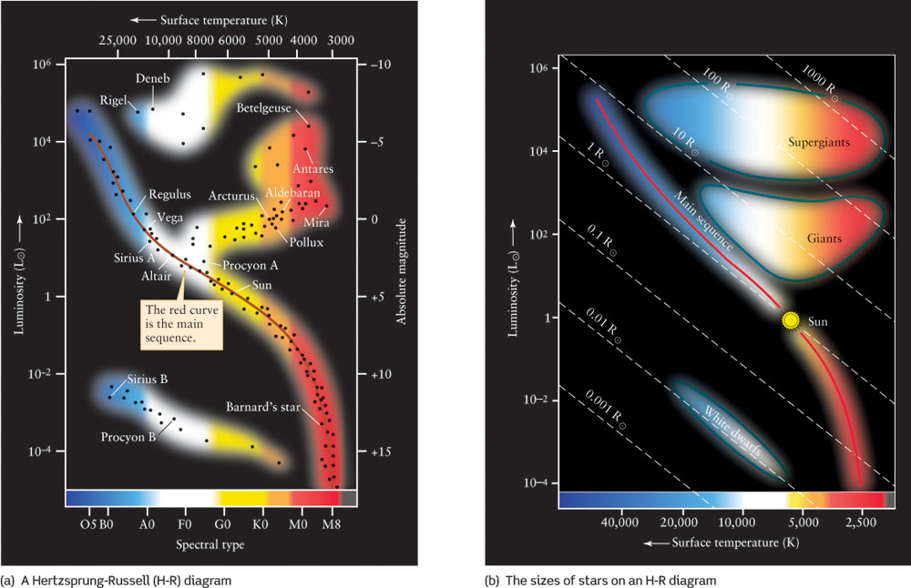
Hertzsprung Russell Diagrams

Slide 23
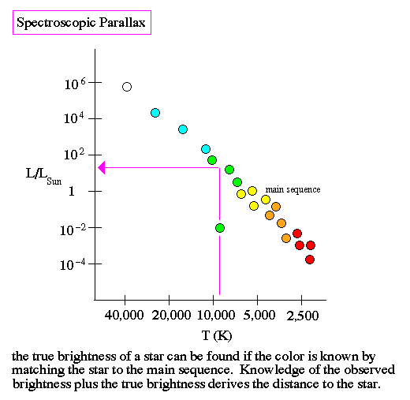
Spectroscopic Parallax Guzman
By “color” they are referring to the spectral classification of the star, determined mostly by temperature. Observed brightness is related to apparent magnitude m. “True” brightness is related to absolute magnitude M. From these the distance modulus equation gives distance.

Slide 24
The Final Exam
40 Multiple Choice Questions = 120 points
new repeat
CH 2-5 6 4
CH 6-10 6 4
CH 11-13 6 4
CH 14, 24 10
40 points of other questions
160 points total: 75% multiple choice, 25% other short answer

